Slide 1
Chapter Extension 1
Collaboration Information Systems for Decision Making, Problem Solving, and Project Management

Slide 2
Study Questions
Q1: What are the two key characteristics of collaboration?
Q2: What are three criteria for successful collaboration?
Q3: What are the four primary purposes of collaboration?
Q4: What are the components and functions of a collaboration information system?

Slide 3
Q1 What Are the Two Key Characteristics of Collaboration?
Cooperation –
  Two or more people working together to achieve a common goal, result, or work product
  Communicating, sharing information, sharing knowledge, combining skills, sharing time

Slide 4
Q1: What Are the Two Key Characteristics of Collaboration? (cont’d)
Collaboration –
A group of people working together to achieve a common goal via a process of feedback and iteration.
  Members must provide and receive critical feedback

Slide 5
Importance of Feedback and Iteration
One person produces something
  It takes time to create a collaborative team
Others review and comment
Make changes
Yes
Changes?
Done
No
Notes:
Iteration is the key.

Slide 6
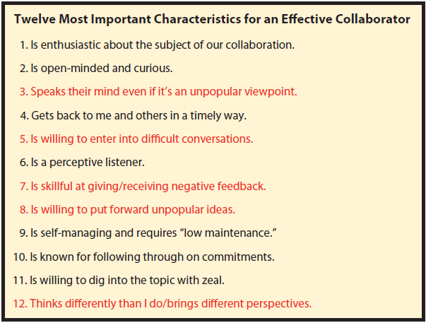
Qualities, Attitudes, and Skills That Make a Good Collaborator

Slide 7
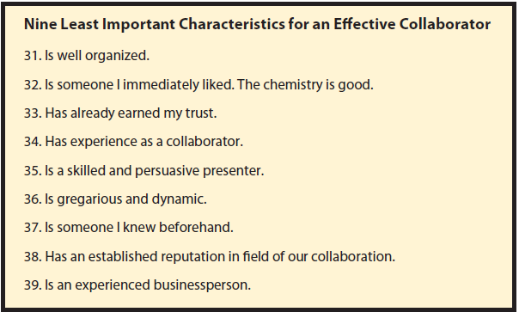
Qualities, Attitudes, and Skills That Make a Good Collaborator (cont'd)

Slide 8
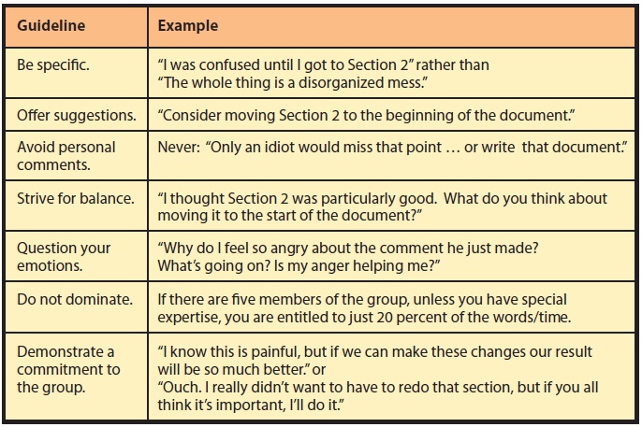
Guidelines for Giving and Receiving Critical Feedback

Slide 9
Warning!
Working team of chief engineer, chief financial officer (CFO), legal counsel, and PR director.
People in group have different education, expertise, life experiences, and different values.
Notes:
Your company is planning to build a new facility critical for success of a new product line and will create 300 new jobs. County government won’t issue a building permit because site is prone to landslides. Engineers believe building design overcomes that hazard, but CFO is concerned about possible litigation if there is a problem. Corporate counsel is investigating best way to overcome county’s objections while limiting liability. Meanwhile, a local environmental group is protesting your site because they believe it is too close to an eagle’s nest. Your public relations director is meeting with those local groups every week. Do you proceed with the project?

Slide 10
Q2: What Are Three Criteria for Successful Collaboration?
Primary criteria for judging team success:
Successful outcome
Growth in team capability
    Improve task skills, share knowledge
Meaningful and satisfying experience
    Important, given recognition, camaraderie
Notes:
“Did we do it?”
“Did we do it within the time and budget allowed?”
Most student teams are short-lived, but business teams often last months or years
With experience, teams can become more effective
Individuals improve at their tasks
Members teach task skills and share knowledge
If an individual’s work is perceived as important and the person doing that work is given credit for it, then the experience will be perceived as meaningful. Recognition for work well done is vitally important for a meaningful work experience.
Camaraderie

Slide 11
Hackman’s Three Characteristics of Team Effectiveness
  Accomplish goals and objectives that satisfy sponsors and clients
  Over time, working together is easier and more effective
  Members learn and feel fulfilled
  “Leading Teams” survey

Slide 12
Q3: What Are the Four Primary Purposes of Collaboration?
Become informed
Make decisions
Solve problems
Manage projects
Share, communicate, document
Operational, managerial, strategic
Structured, unstructured
Notes:
These four purposes build on each other. You cannot make good decisions if you do not have the skills to inform yourself. You cannot solve problems if you are unable to make good decisions. And you cannot manage projects if you don’t know how to solve problems!

Slide 13
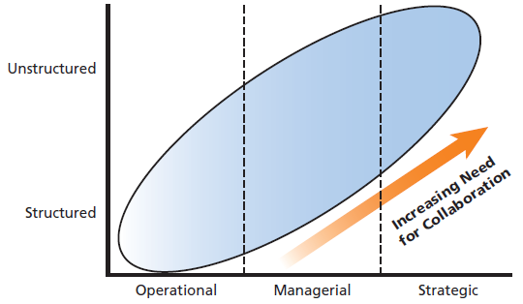
Collaboration Needs for Decision Making

Slide 14
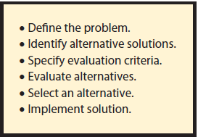
Problem Solving Tasks
Notes:
GearUp team was assigned the problem of finding ways of reducing operational expenses. As part of the informing purpose, the group needs first to ensure team members understand this goal and have a common definition of what an operational expense is.

Slide 15
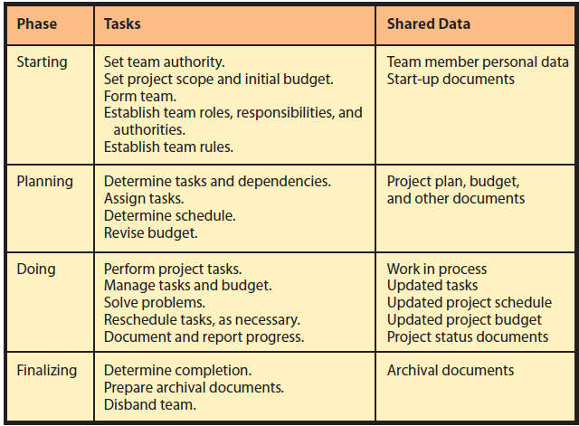
Project Management with Four Phases
Notes:
Projects are formed to create or produce something.

Slide 16
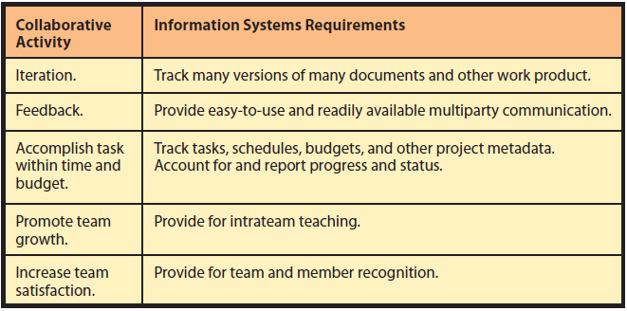
Q4: What Are the Components and Functions of a Collaboration Information System?
Notes:
Collaboration System Requirements

Slide 17
Five Collaboration System Components
  Procedures - Communication & Content Sharing
  Hardware - Most collaboration systems hosted on organizational servers or the cloud
  Software - Collaboration programs applications like email or text messaging that support collaborative work
  People - The individuals who are collaborating
  Data - Project data and project metadata

Slide 18
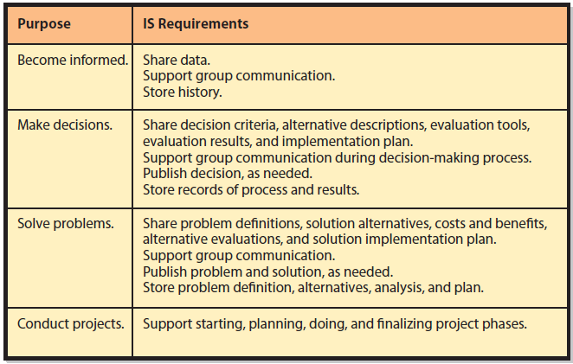
IS Requirements for Different
Collaboration Purposes
Notes:
These requirements fall into communication and content-sharing categories.
Note the difference between the terms collaboration system and collaboration tool. A collaboration tool is the program component of a collaboration system.

Slide 19
Active Review
Q1: What are the two key characteristics of collaboration?
Q2: What are three criteria for successful collaboration?
Q3: What are the four primary purposes of collaboration?
Q4: What are the components and functions of a collaboration information system?

Slide 20
