Slide 1

Need to WITHDRAW from one of Prof. Schmidt’s Courses?
Easy as 1 – 2 – 3
Step 1: Fill out the green highlighted sections of GRU Withdrawal Form (see my example form →)
Forms are available online or at the registrar’s office
Step 2: Slide form under Professor Schmidt’s
office door
Step 3: Professor Schmidt will :
Fill in last attendance date
Sign the form
Place it an envelope
Tape the envelope to her office door for your retrieval
Step 4: Retrieve your form
and turn it into the Registrar prior to midterm
Midterm Date:
______________
GRU Withdrawal Policy
Before Midterm: Receive a W by having your professors sign a form
After Midterm: Receive a WF. Please see the registrar.
Consult the ASU Student Handbook for details and exceptions.

Slide 2
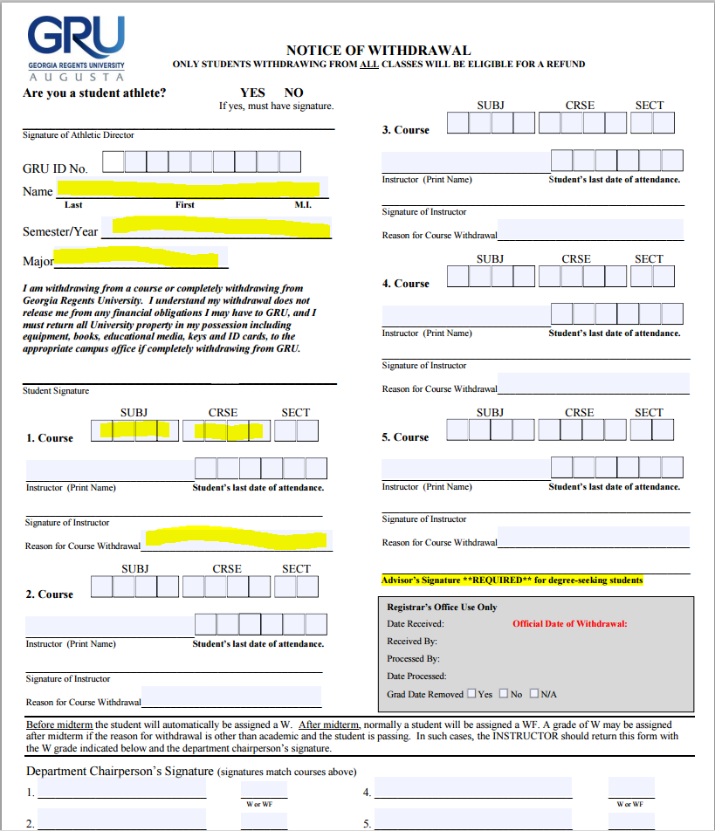
COMPLETE
All Highlighted Areas
THEN
Follow Instructions on Slide 1

