Slide 1
Opioids
Lecture II

Slide 2
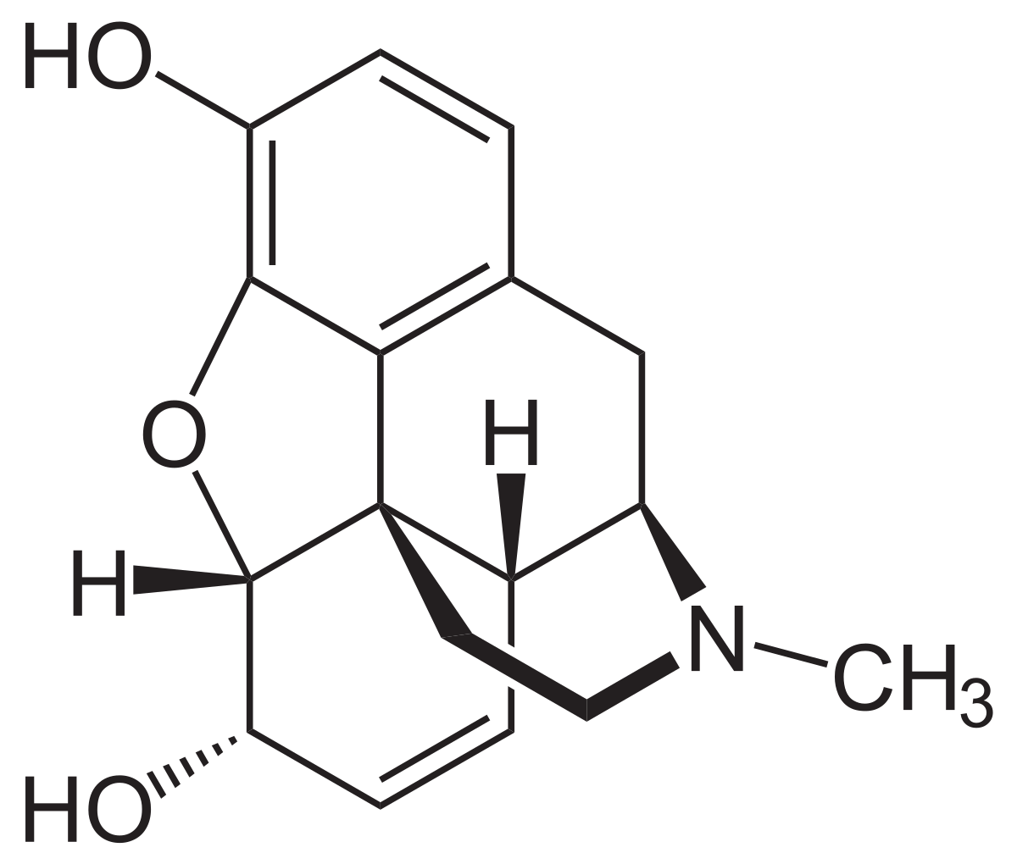
Morphine
Centrally acting analgesic
Benzylisoquinoline structural backbone
Starting point for various other opioids

Slide 3
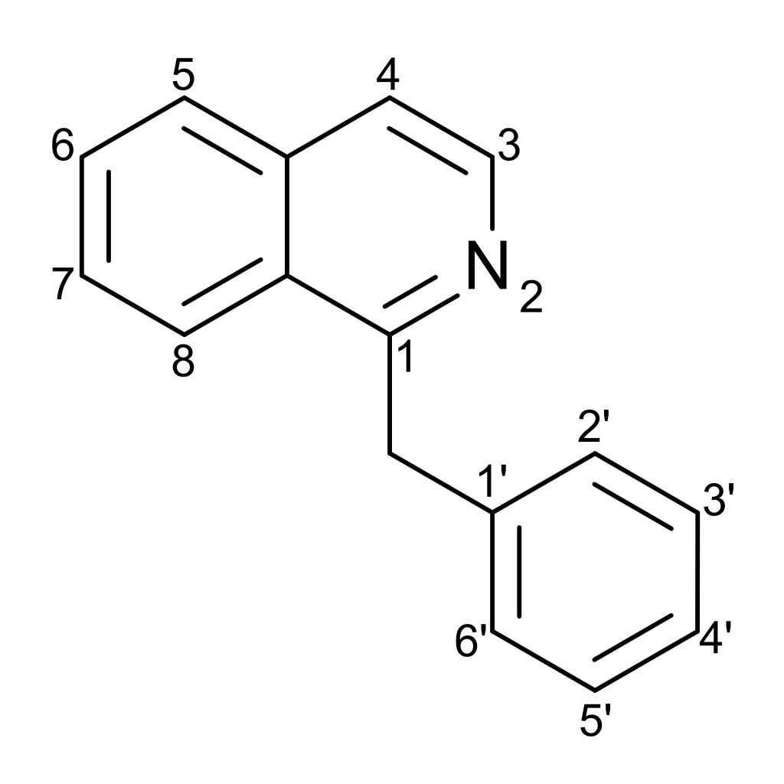
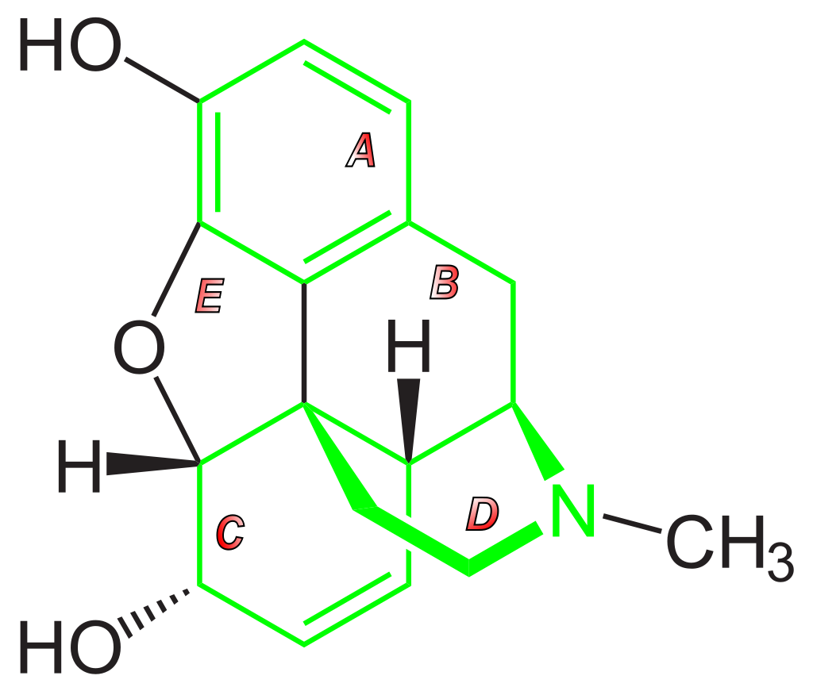
Benzylisoquinoline Backbone of Morphine

Slide 4
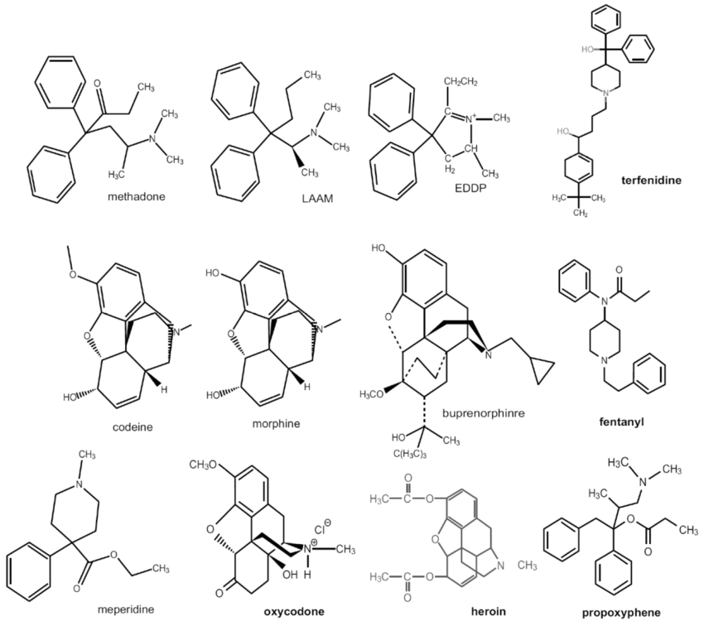
Other opioids

Slide 5
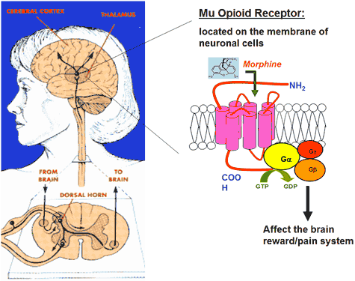
Opioid Receptors
17 known opioid receptors
The primary three are mu, kappa, delta
Three subtypes of mu - μ1, μ2, and μ3
The mu receptor is the type most related to opioid use
mu receptors are what cause opioids to become addictive, as well as produce analgesic and euphorigenic effects.

Slide 6
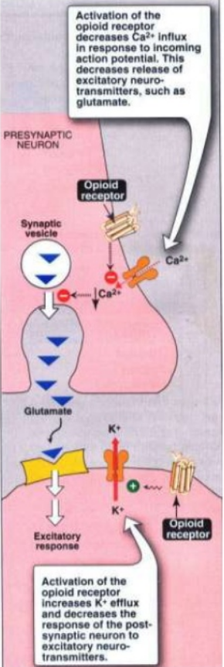
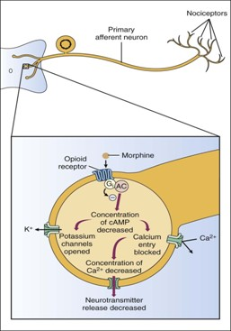
Mechanism of Action
Opioid receptors are coupled with inhibitory G-proteins and their activation has a number of actions:
Closing of voltage sensitive calcium channels (Reduces Ca²⁺ influx)
Stimulation of potassium efflux leading to hyperpolarization and reduced cyclic adenosine monophosphate (cAMP) production.
Overall, the effect is a reduction in neuronal cell excitability – reduced transmission of nociceptive impulses.

Slide 7
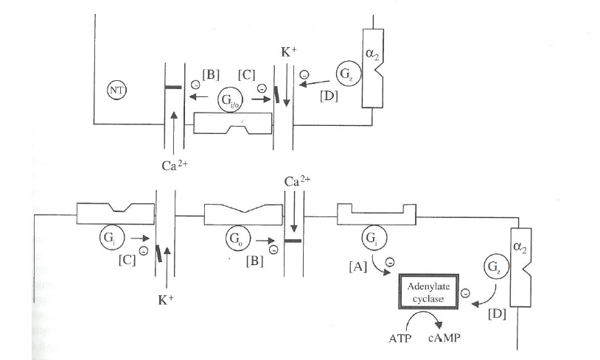
Summary of Receptor Opioid Signal Transduction Mechanism

