Slide 1
Introduction to Opioids
Stephanie Myers
Chemistry 4800
Spring 2019

Slide 2
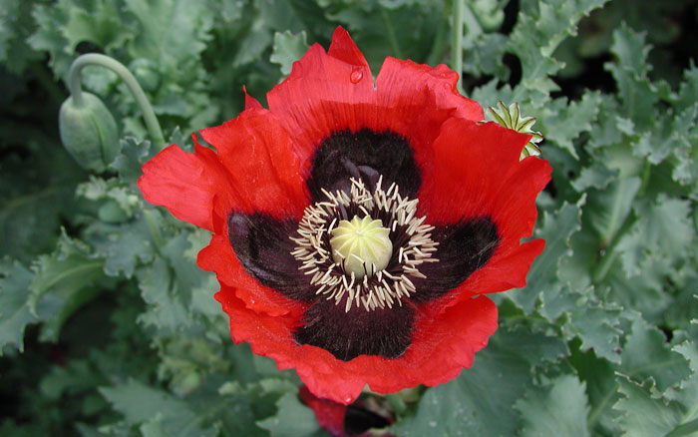
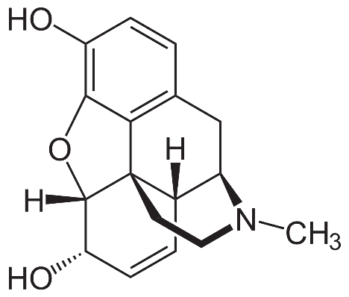
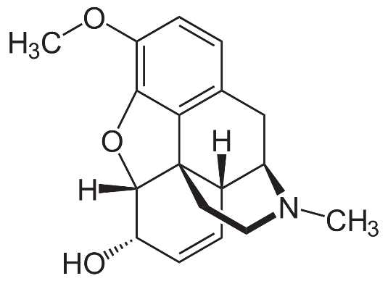
What is an opioid?
Dried extract of opium poppy
Raw opium typically about 10% morphine
With a little codeine thrown in….
Opiate = alkaloid derived from opium poppy
Opioid = substance that produces same effect by binding to opium receptors

Slide 3
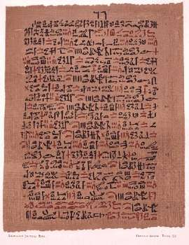
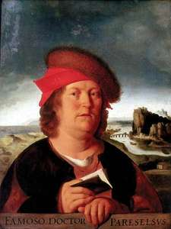
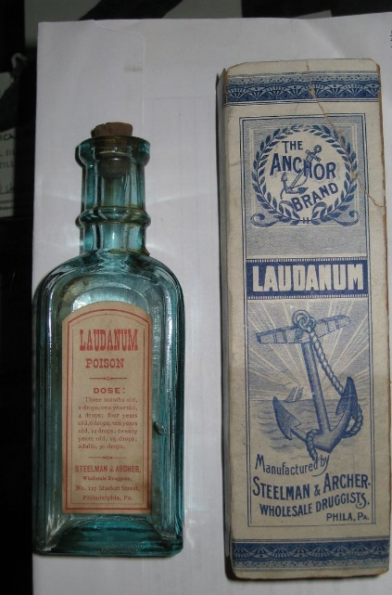
Early history
First recorded use
1500 BCE in Ebers papyrus
Laudanum
Deodorized tincture of opium
First reformulated by Paracelsus 1522 CE
10 mg morphine/mL
Other classic “medicines”
Dover’s powder
Paregoric powder
Godfrey’s cordial

Slide 4
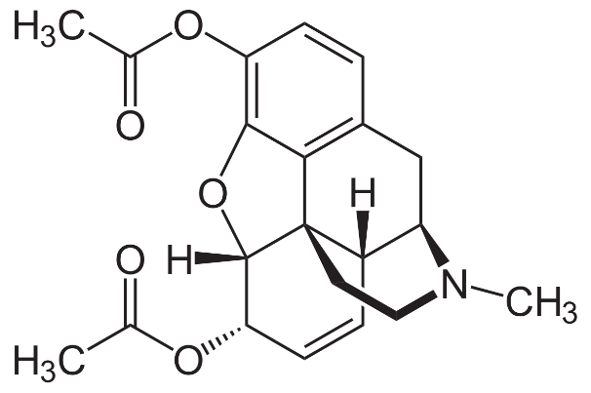
Early chemistry
Morphine isolated by Armand Séquin in 1804
Heroin synthesized by Charles Alder Wright in 1874
Marketed by Bayer as cough medicine in 1898

Slide 5
Other opioids
LAAM = Orlaam
Oxycodone = Percocet or Oxycontin
Propoxyphene = Darvon
meperidine = Demerol
hydrocodone = Vicodin
Loperamide = Imodium

Slide 6
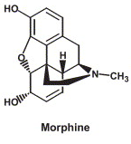
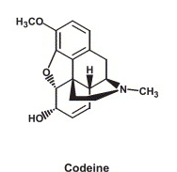
Famous opioids
Morphine
The original, isolated from the opium poppy
Used for pain relief from antiquity
Codeine
Natural, in smaller quantities from poppy
Used for cough relief
Can be used for pain if body is capable of metabolizing to morphine
(not everyone has the gene)

Slide 7
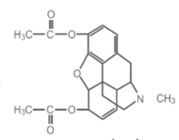
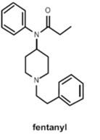
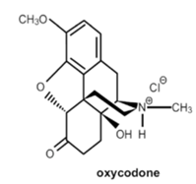
More Opioids
Heroin
Easily synthesized from morphine
Not directly more effective, but rapidly metabolized to something that is
Gives a bigger “rush” than morphine
Acid form very soluble; base form is not
Fentanyl
Short acting/highly potent (50 -110 times more than morphine)
Can be delivered transdermally
Oxycodone and hydrocodone
Typical prescriptions

Slide 8
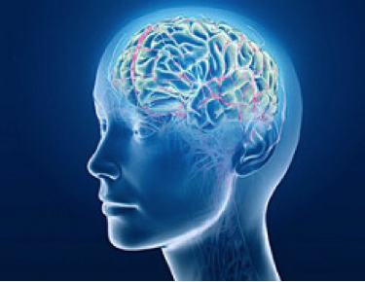
Therapeutic effects
Analgesic = pain relief
Blocking pain receptors in brain (mostly)
Euphoria = feeling of well-being/happiness
Releases dopamine
Antitussive = cough suppressant
Particularly codeine and dextromethorphan

Slide 9
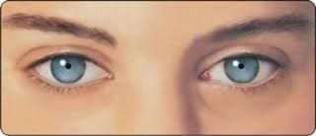
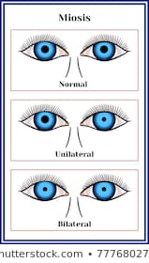
Toxic Effects
Respiratory depression
Acute lung injury
Low blood pressure
Pinpoint pupils (miosis)
Seizures
Muscular rigidity
Nausea/vomiting
Constipation
Flushing

Slide 10
Addiction
This is the big problem
20 – 30 % of patients misuse prescribed opioids
8 – 12% get “opioid use disorder”
4 - 6 % transition to heroin
80% of heroin users started with prescription opioids
Increase in opioid addiction from 2016 to 2017: 30 – 70%
depending on area
March 2018 (NIH): 115 people/day die of overdose
cost of misuse: $78.5 billion/year
for: healthcare, lost productivity, addiction treatment, court costs

Slide 11
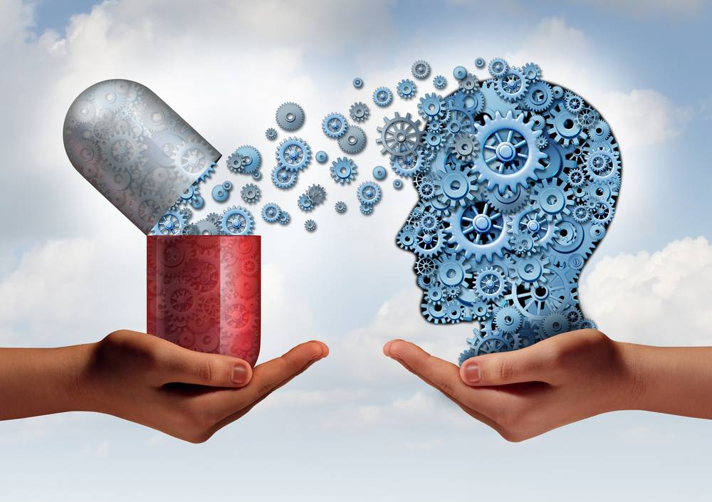
Addiction
Powerful, compulsive urge to use even if not medically necessary
Chemistry of brain is changed
Tolerance ensues: More drug for same effect
Dependence: physical symptoms of withdrawal when stop using drug
Muscle cramps, diarrhea, anxiety
Everyone can get dependent,
not everyone gets addicted

Slide 12
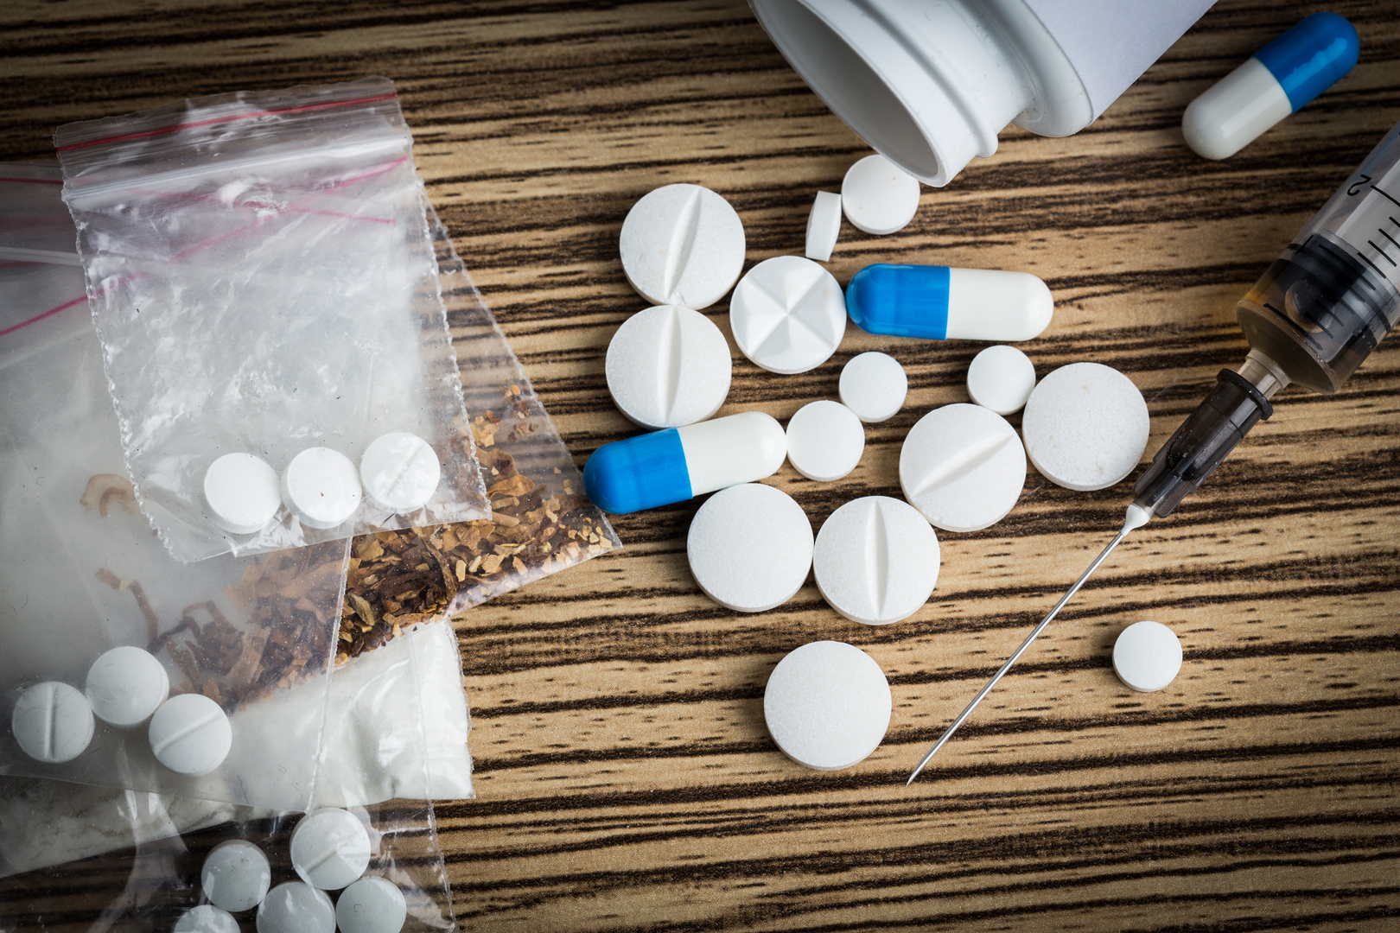
6 signs of opioid addiction (prescription opiods)
Not taking medication as prescribed
Taking the medicine for reasons other than pain
Running out of medicine early
(someone else taking it may be a sign of THEIR addiction)
You are preoccupied with your medication
You have changed the way you take them
Mix with other drugs; change formulation (e.g., grind them up)
Your family is worried about you
Source: Cleveland Clinic

Slide 13
Overdoses
Current estimates are over 20,000 overdoses/year for prescriptions and over 10,000/year for heroin

Slide 14
Another way to look at it ONE county! This is the county that includes Cleveland, OH

Slide 15
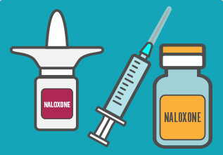
Treatment—Acute poisoning
Naloxone (Narcan)
used to reverse respiratory depression
Opioid antagonist
Rapidly absorbed
Competitively bind to the μ receptor
Short acting
Reverses effect of opioid
Shows no effect if opioids are not present

Slide 16
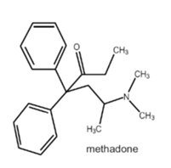
Treatment--Addiction
Methadone
Used as chronic pain reliever
Long duration effects
Used as maintenance substitute for opioid dependence
Used for over 40 years this way
Other (similar) agents used on Opioid substitution therapy
LAAM, Buprenorphine, Clonidine

Slide 17
Legal Status
Legal (schedule III or IV) | By prescription (schedule II) | Illegal (schedule I)
burprenorphine | Methadone fentanyl | heroin
Codeine (III – V) depending on formulation | Morphine opium
Dextromethorphan (V) | Hydrocodone oxycodone

Slide 18
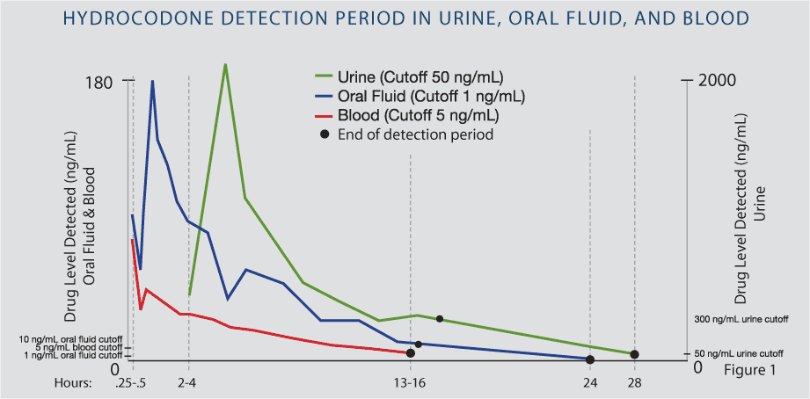
Forensic detection
Sampling
Blood
Urine
Techniques
Chemical tests
LC MS
Immunoassay
Detection of metabolites

Slide 19
Ideas for your paper?
Analytical
Biochemical
Organic
Inorganic
Physical

