Slide 1

Resplendent Flipping Technique: A custom Design Model Which Enables Flipped Delivery of Any Concept From Any Discipline With or Without Technology
Buffie Schmidt, MBA, Ed.S.
February 12, 2016

Slide 2
Research Need
GOAL
Improve Student Averages in Economics
Improve Economic Retention for future courses
Desire More Time in Class for Current Topics and Concept Application

Slide 3
Flipping
LIT REVIEW
Discovered
  Inverted Classroom, Backwards Classroom
  Reverse Instruction, Peer Instruction
  Blended Learning
….New Twist
  Focus on Higher Level Thought (deeper learning)
  Maximize Time with Instructor
  Increased one-on-one opportunities (Bloom 1984)

Slide 4
My Approach
GOAL
Schmidt Approach (Backward Course Design)
  What does the student need to know?
  Determine best way for them to learn (instructor preference/fun)
  Develop a way to evaluate their learning
  Write the syllabus
Notes:
Backwards course design is how I develop any new course I am given!

Slide 5
My Design Needs
GOAL
Flipping as a part of the Schmidt Model
  Brings semi-knowledgeable students to you on day 1
  Allows a fun and engaging learning experience
  Increases job satisfaction for instructor
  Provides more time:
    Wider Breadth or Deeper Depth of concept knowledge
  Offers opportunity for students to be:
    Amazed at facts and Proud of themselves
  Forces students to take responsibility for their education
    Time management, communication, preparation, concepts
    Provide specific expectations, build in allowances
Notes:
(What do they need to know, Determine best way for them to learn that is also fun for me, Develop a way to evaluate their learning, Write the syllabus)

Slide 6
Desired Classroom Experience
GOAL
Traditional
Flipped
Teach by Telling
Teacher = Talker
Student = Bored
Learning = Teacher
Class = Teacher focused & Knowledge/ Understanding levels
Teach by Questioning
Teacher = Tutor
Student = Engaged
Learning = Student
Class = student focused &
Application/Analysis levels
Notes:
Before we go there…..What does a flipped course/assignment look like in and out of the classroom?

Slide 7
My Design - Data
FINDINGS
Boring Basic verse Flipped Classroom
37-55 students/section
Mostly Sophomores
Some Juniors
Few Freshmen/Seniors
50% Business Majors
30% Political Science
No significant differences amongst the cohorts
Evening classes were smaller with more upperclassmen and non-traditional students
Notes:
Demographics of my students.

Slide 8
My Design - Data
FINDINGS
Flip#2
Boring Basic verse Flipped Classroom
Flip#1
Flip#1
Spring Semester:
Day classes
Spring Semester:
Evening classes
Fall Semester:
Improved Flip Assignment
Same Spring Semesters
2011 & 2012
Notes:
Explain cohorts are Semester specific (Spring-to-Spring and Fall-to-Fall).
Explain flipping assignment was improved between spring and fall

Slide 9
My Design - Data
FINDINGS
Greater % assigned to Flipped & Performance Assessment!
*70% from Higher Order thought assessments
Flip#2
Boring Basic verse Flipped Classroom
Flip#1
Flip#1
*All numbers are percent values
Notes:
How did I adjust my course evaluation percentages.

Slide 10

Student Outcomes
FINDINGS
Boring Basic verse Flipped Classroom
*Spring Semesters – Mind Map (flip assignment)
*Fall Semester – Online Homework (flip assignment)
Notes:
What were the student results in letter grades?
-After the final flip (very reputable and repeatable) I had 18% decrease in DFW!!

Slide 11
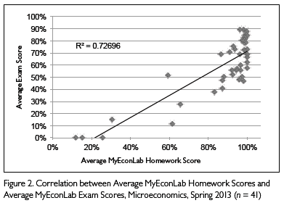
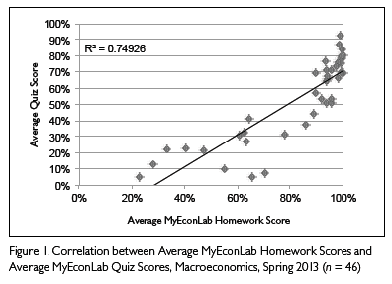
Online Courses
FINDINGS

Slide 12
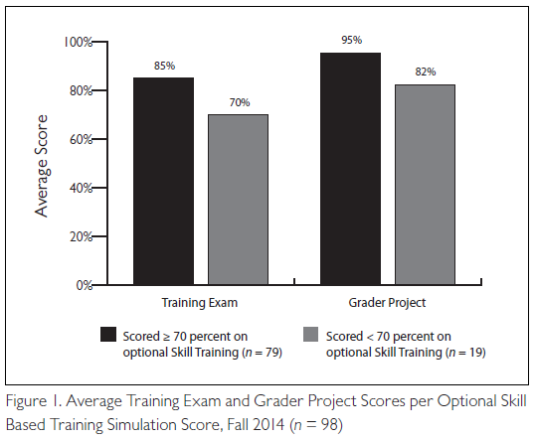
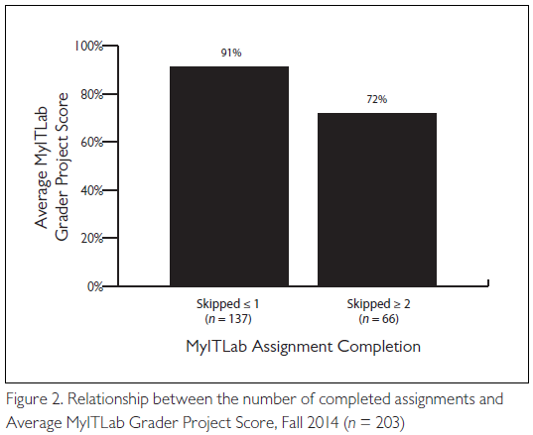
MIS Courses
FINDINGS

Slide 13
Flipped by Schmidt Process
MY FLIPPING DESIGN
Evaluate
Class Time
Before Class
After
Class
Choice
Differentiation
Higher Order Thought
Reinforce Concepts
Collaborate
Student Centered
Integrity
Technology?
Retention
Basic Concepts
  Assessment/Findings
Evaluate *new

Slide 14
My FLIP
MY FLIPPING DESIGN
Traditional
Flipped
Class Lecture
  Homework/Quiz
Class Lecture
  Homework/Quiz
--repeat
Exam
--repeat
Final Exam
  HW: Read & Do Homework
Class Activity
  HW: Read & Do Homework
Class Discussion / Small Groups
--repeat
Exam
--repeat
Project Based Learning Pjct
*Boring (for the student)
*Resulted in high DWF rate
*We must change our approach to evaluation if we really desire to change our approach to teaching – students study according to assessment practices!
Notes:
Before we go there…..What does a flipped course/assignment look like in and out of the classroom?

Slide 15
Schmidt says...
Design Your Flip!
SCHMIDT MODEL
OUTLINE
How to Flip Your Course – Flipped by Schmidt
Design the deliverable considering
  Where is your concept used in real life?
  What assignment will benefit students beyond specific concept understanding?
  Evaluation of group or individual assessment (rubric?)
Don’t focus on the concept you need them to learn!
Do focus on how the concept will be utilized/applied in their life.
  Know your students. Personalities, goals, majors, year in school, learning styles
Whenever possible:
  Allow students to choose
  Partner with local businesses
Notes:
Design Outline to help you brainstorm.

Slide 16
Evaluate
SCHMIDT MODEL
Main Concept/Chapter Issue (Gains From Trade)
Specific Concept Struggle: Why is this difficult? (Math Inclusion)
Big Picture: Where in Real Life? What Career Path? (Politician: Budgets; Business Owner: P&L, ROI; Taxes)
Brainstorm: Determine Assignment that requires this Real World Activity/Skill. (Class Discussion on Campaign Ads; Analysis of Real Financial Stmts)

Slide 17
Flipped Assignment Examples
Schmidt Model
BEFORE Class
Read Chapter
Watch Video (lecture, news, etc)
CLASS Time
Class Discussion
Small Group Assignment
AFTER Class
Journal Entry
Interview Professional
Preview PowerPoint (static, voiced or interactive)
Online lab Homework
End of Chapter Question(s)
Group Assignment with specific Deliverables
Mind Map Concepts
End-of-chapter Problem
Small Group Discussion
Clicker Questions
End-of-chapter Problems
Project Based Learning Assignment
Real-Life Document Analysis
Advanced Lab
Case Studies
Game
Individual Reflection
Additional Lab
GOAL: Review Key Concepts
GOAL: Higher Order Thought / Retention
PowerPoint Presentation
Informational Video
Develop Test Questions
Fishbone Diagram
GOAL: Review/Learn Basic Concepts
  EVALUATION
EVALUATION

Slide 18
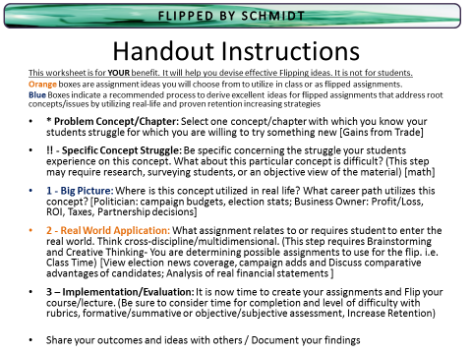
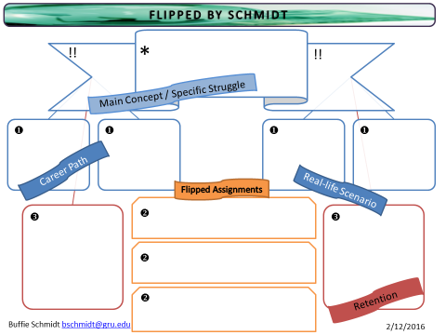
Schmidt says...
Design Your Flip! (Exit Exercise)
Flip Your Class!
You Do It
Notes:
Now You Do It!

Slide 19

Handout Instructions
FLIPPED BY SCHMIDT
This worksheet is for YOUR benefit. It will help you devise effective Flipping ideas. It is not for students.
Orange boxes are assignment ideas you will choose from to utilize in class or as flipped assignments.
Blue Boxes indicate a recommended process to derive excellent ideas for flipped assignments that address root concepts/issues by utilizing real-life and proven retention increasing strategies
* Problem Concept/Chapter: Select one concept/chapter with which you know your students struggle for which you are willing to try something new [Gains from Trade]
!! - Specific Concept Struggle: Be specific concerning the struggle your students experience on this concept. What about this particular concept is difficult? (This step may require research, surveying students, or an objective view of the material) [math]
1 - Big Picture: Where is this concept utilized in real life? What career path utilizes this concept? [Politician: campaign budgets, election stats; Business Owner: Profit/Loss, ROI, Taxes, Partnership decisions]
2 - Real World Application: What assignment relates to or requires student to enter the real world. Think cross-discipline/multidimensional. (This step requires Brainstorming and Creative Thinking- You are determining possible assignments to use for the flip. i.e. Class Time) [View election news coverage, campaign adds and Discuss comparative advantages of candidates; Analysis of real financial statements ]
3 – Implementation/Evaluation: It is now time to create your assignments and Flip your course/lecture. (Be sure to consider time for completion and level of difficulty with rubrics, formative/summative or objective/subjective assessment, Increase Retention)
Share your outcomes and ideas with others / Document your findings
Notes:
Not for students!

Slide 20
FLIPPED BY SCHMIDT
*
!!
!!
Main Concept / Specific Struggle
u
u
u
u
Career Path
Flipped Assignments
Real-life Scenario
v
w
w
v
v
Retention
Buffie Schmidt bschmidt@gru.edu
2/12/2016
Notes:
Sample

Slide 21
FLIPPED BY SCHMIDT
* Gains from Trade
!!
!!
MATH
Decisions based on information
Main Concept / Specific Struggle
u
u
u
u
Budgets
Elections
Statistics
Profts/Loss
Taxes
ROI,
TVM
Politician
Business Owner
Career Path
Flipped Assignments
Real-life Scenario
v
Locate profit/loss article in newspaper discuss possible gains from trade realized/available
w
w
Mind Maps
Fish Bone Diagrams
Create Exam
Journal Reflections
Professional Interviews
v
Review elections coverage and discuss comparative advantages of candidates and effect on candidacy
Locate financial statements for large corporation and discuss possible Gains from Trade utilized
v
Retention
Buffie Schmidt bschmidt@gru.edu
2/12/2016
Notes:
Sample

Slide 22
Take Away
FURTHER RESEARCH
Things I Discovered
  This really works! (Decrease DWF rates)
  Integrity of Flipping Assignment is important!
  Organization and Consistency is important! (See time commitment.)
I was able to:
  Add more current events to curriculum
  Achieve higher order level of thought in class discussions
  Witness critical thinking skills develop
  Course debates were so engaging a graduate faculty member duplicated and continues to use in her MBA course.
Notes:
What did I take away from this experience.

Slide 23
Take Away
FURTHER RESEARCH
Time Commitment
  Preparation of Flipped Assignments
    Integrity, Concept based, Assessable
  Incorporating higher-level thought activity into curriculum
  Managing student expectations and the ‘flipped experience’
    Explaining concept
    Specific before/during/after class expectations
    Encouragement for slow / Challenges for quick Learners
Well worth the time based on
  Final assessment
  Student comments (need to study these!)
Notes:
Emphasize preparation of students. Make sure they know what you expect of them and what they should expect of the course!
-I am the score keeper and do not ‘give out’ grades
-business class = business environment = no late assignments EVER
-communication: method, timeliness, topics, design, etc.

Slide 24
Research Opportunities
FURTHER RESEARCH
Differences among traditional vs non-traditional student benefit
Differences in course evaluation comments
Determine retention level success by following up months later
Others?
Notes:
How can implementing Flipping in your class benefit your research?
Now let’s look at some Flip examples/ideas for various disciplines!

Slide 25
Questions?
QUESTIONS

Slide 26
Questions?
QUESTIONS

Slide 27
Schmidt says...
Successful Flips & Results
SCHMIDT MODEL
OUTLINE
An Assessment/Guide Paper
Flipping Model (Guide)
Explain Process
Describe Possible Assessments
An Assignment Paper
Details Flips for Various Disciplines
Provides Achieved Results
Notes:
Design Outline to help you brainstorm.

Slide 28
Discipline Integration
Flip Your Class!
EXAMPLES
Chemistry
  http://www.chemisme.com/
  Videos for Lab Prep, instructions, examples of accurate outcome to decrease time needed for lab or increase rigor of lab assignment
  More time in class for practice problems, discussion, group quizzes, mixed session assignments-students can self pace
  http://kulowiectech.blogspot.com/2011/01/flipping-history-classroom.html
History
  Essay practice
  Guest speakers
  Field trip experiences: monument documentation, history research, museum visits
  In class activities: Cave writing exercise, replicate archeological dig

Slide 29
Discipline Integration
Flip Your Class!
EXAMPLES
Political Science/Economics
  Assure readiness - Baseline preparedness (math, basic terms)
  Dive deeper - Campaign analysis/preparation: Require small groups to determine best path for campaign on various hot topics, have group recorder turn in paper at end of class with requested items.
  PBL: Commodity from production to consumption
  Small groups create economic graphs from newspapers
Psychology
  https://www.youtube.com/watch?v=QTDQaaVWEzI
  Psychiatric intervention and cultural implications
  Loci memory technique benefits those with depression

Slide 30
Discipline Integration
Flip Your Class!
EXAMPLES
Communication
  Require (memo, resume, cover letter) be brought to class prior to class discussion on written communication chapter
  Require 2 minute informational/persuasive speeches on topic of choice on day covering oral communication. (do not have to choose everyone, allow class to critique speakers, offer extra credit for volunteers)
English
  The local newspaper is an excellent source of inaccuracies
  Utilize your library!
Physical Education
  Video of Rules, Sportsmanship, Team Selection

Slide 31
Discipline Integration
Flip Your Class!
EXAMPLES
Mathematics/Finance
  Require analysis of firm of choice using specific equation or concept being covered (remember there is not a need to apply all of your knowledge to concept specific assignments)
Nursing
  http://www.youtube.com/watch?v=UL0ADbzCR2U&list=PLJ5kKhwVxA5Ju4Iv0ZBqVGiUx1-HSQqMJ
Sciences, Art, Music, Logistics, or any Discipline
  Follow outline to follow.....
Brainstorm with
Colleagues!

Slide 32
Discipline Integration
Flip Your Class!
EXAMPLES
Technology Resources
  Discussionthreads.com
  Prezzi
  Free graphic organizer software
  Anymeeting.com
  Edpuzzle.com (video)
“Old School” Resources
  Library
  Personal touches (interviews, surveys)
  Text/book summary
  Lab report
Incorporate Technology – or NOT!

Slide 33
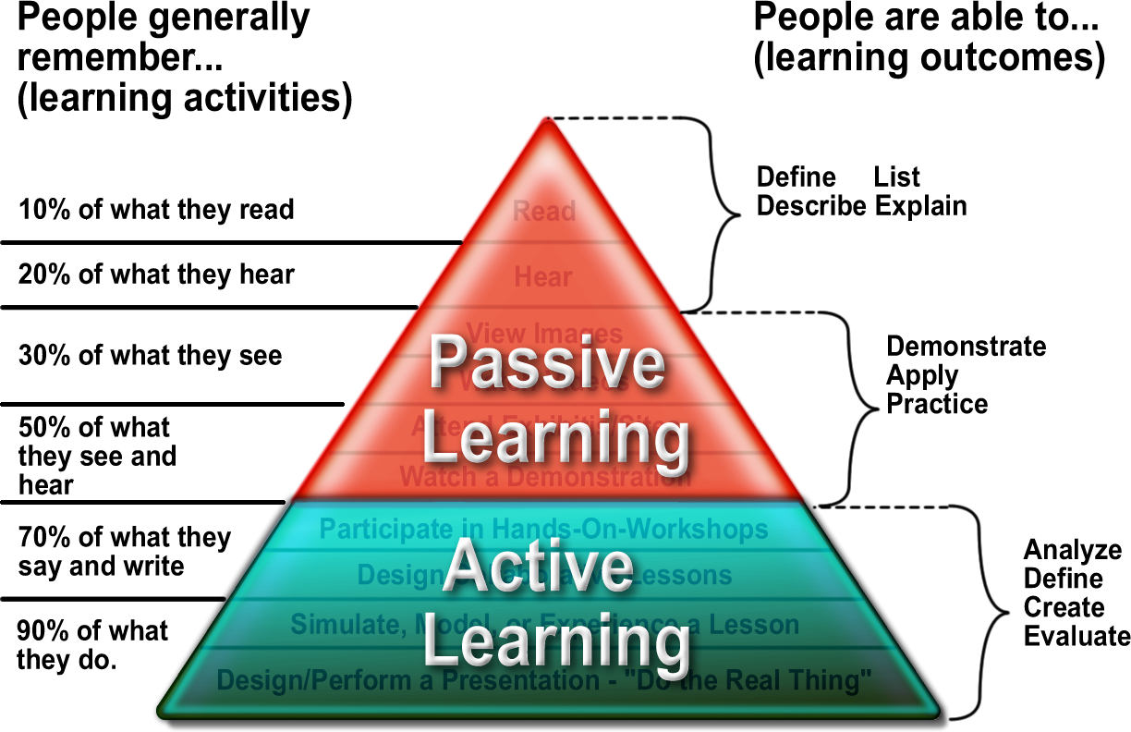
Active Learning
Supplement
Return to #19
Step 3: Thought
*wordpress.com

Slide 34
Definitions
Supplement
Constructivist Teaching Style
  Fosters critical thinking, develops independence
  Learning builds on knowledge already possessed
  Students retain more when actively engaged
  Field trips, experiments, research presentations,
Active Learning
  A student must be involved in the learning process
  Requires student to engage in higher order thoughts
  Class discussions, learning group, debate, game, video reaction, study buddies (learning cells), etc.
Project Based Learning
  Requires students to investigate
  Associates theory with real-life situations
Authentic Assessment
  Student perform or simulate the skill learned
  Rubric evaluates “What should the student be able to do?”
Return to #6 Teaching Philosophy Slide
Notes:
Inquiry based learning and project based learning are both methods of learning approaches supported by the constructivism

Slide 35
Process Examples Defined
Flipping Technique
BEFORE Class
Step 1: Require assignment on concepts being covered in class to be completed prior to class
Voiceover on PowerPoint
Video lecture (Khan Academy, iTunes University, personal lecture capture, educational YouTube)
News clip (selected or unsolicited)
Homework based on concept/chapter
Group assignment with specific deliverables
Others?
*Also assists with time management skills
**Forces student to own learning
Notes:
Specific Deliverables: Locate a newspaper article that shows an example of supply and demand and draw me a graph depicting a shift a curve and provide a 1-2 sentence statement explaining the curve shift in economic terms.

Slide 36
Process Examples Defined
Flipping Technique
BEFORE Class*
Step 2: Integrity of Flipping Assignment:
Ensure students ethically complete the pre-activity
Short quiz at the beginning of class
  Built into grade or for extra credit
Begin class with discussion assuming Blooms Level 1 & 2 knowledge levels
  Dismiss class if the majority are unprepared and do not re-cover in the next class period
Begin class with short group exercise requiring application
  Take up the papers with names
*Important at the beginning of the semester!
Notes:
Getting semi-knowledgeable students to you on Day 1 depends upon your ability to effectively perform this step!
Unprepared students (those that did not complete the pre-assignment) should be completely lost in class!

Slide 37
Process Examples Defined
Flipping Technique
CLASS Time
Step 3: Thought Provoking, Goal Assignments used to stimulate deeper thought, improve critical thinking, and encourage creative, application, and analytical thought resulting in excitement and concept retention
Current Event Class Discussion
  Encourage and Reward participation
Small Group Discussions
Clicker Questions
Working End of Chapter Problems (math)
Solving Project Based Learning Assignments
Peer-to-Peer Learning
*Goal assignment: What have you always
wished you had time to do in class?
Notes:
Warn against dropping lowest grade! Instead provide opportunity to replace grade! One counteracts responsibility and one increases it.

Slide 38
Process Examples Defined
Flipping Technique
CLASS Time
Step 3: Thought Provoking, Goal Assignments used to stimulate deeper thought, improve critical thinking, and encourage creative, application, and analytical thought resulting in excitement and concept retention
Real-Life Document Analysis (hand on, labs)
Problem Solve/Clarify
Individual Reflection
Course Projects:
  Debates
  Presentations
In-depth Application
Case Studies
*Active Learning Assignment Assistance

Slide 39
Process Examples Defined
Flipping Technique
AFTER Class
Step 4: Follow up Assignment in an attempt to solidify the imprint of the newly gained knowledge on the student’s mind.
Additional Experience –
After class assignment of choice
  Write in journal
  Interview professional
  Mind map the concepts
  Review of Key concepts
  Fishbone diagram
Students Engage and Retain more when they have choices
*Consider requiring a minimum number to be
completed over the semester in a portfolio
Notes:
Emphasize CHOICE and INSTRUCTOR PREFERENCE

Slide 40

Process Examples Defined
Flipping Technique
FINDINGS
Step 5: Results Assessment
Compare – was your “flip” effective
  Exam Scores
  Embedded Questions assessing specific Learning Outcomes
  Overall Course Grades
  Course Evaluations
  ETS scores
*Do NOT STOP at assessing your Goal!
-Look for other benefits to students/faculty or areas for improvements to the design?
Notes:
What was your GOAL?
Did you Achieve Your Goal?? Yes or No – DO NOT STOP THERE!
What else did you Achieve?
Excellent Research Opportunities!

